Slide 1


Working with geographical coordinates in R
Merging data by longitude and latitude
Sebastian Wójcik, PhD
Statistical Office in Rzeszów
Statistics Poland
Madrid, 7 th July 2023

Slide 2
Contents
Matching of accommodation establishments
Matching data by longitude and latitude
Results
2

Slide 3

Matching of accommodation establishments
Q: How do we check which webscraping objects we already have in the survey frame ?
A: You can use object names, addresses as well as geographical coordinates.

Slide 4
Matching of accommodation establishments
Q: How to use the names and addresses of objects?
A: Calculate the similarity between names and addresses in the survey frame and the base from webscraping using, for example, the Levenshtein, Jaro-Winkler or Jaccard formula. This is known as a fuzzy search.
Q: And what's next?
A: Pair objects with the most similar names or addresses.

Slide 5
Matching of accommodation establishments
Q: How do I use geographical coordinates?
A: Calculate the distance between objects in the operative and base from webscraping using, for example, the haversine formula or the Vincenty formula.
Q: Can't you use a simpler formula?
A: The larger the country, the greater the discrepancies the 'school' distance formula will generate.

Slide 6
Matching by geographical coordinates
First approach:
Deterministic pairing: we paired objects by coordinates exactly as if they were ID numbers.
The vast majority of paired objects were paired correctly.
But we paired very few objects. Are our survey frames were so bad...?
The geographic coordinates in both sources have a different precision, i.e. the number of decimal places. We have not made some obvious connections.
Let’s make the same precision of geographical coordinates in both data sets.
Results improved - but slightly

Slide 7
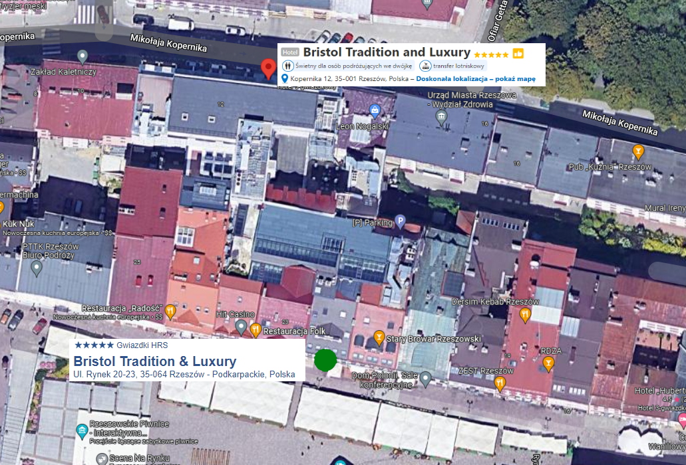
Data linkage methods
One accommodation establishment can have two different addressess on two different reservation websites.

Slide 8
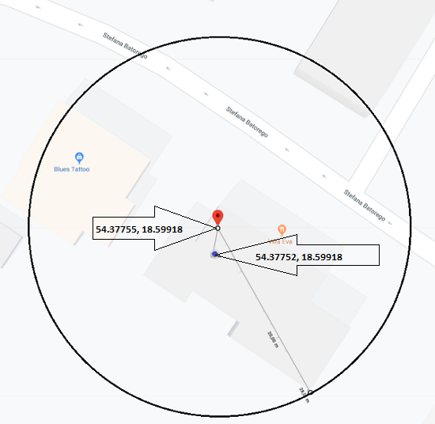
Matching by geographical coordinates
Second approach:
Pairing by distance: we paired the objects closest to each other by coordinates
It matched objects several kilometres apart. These are obvious mismatches.
Let's set a critical distance value. If the nearest object from the survey frame is more than the critical value away - no connection. Let's start with 30 m.

Slide 9
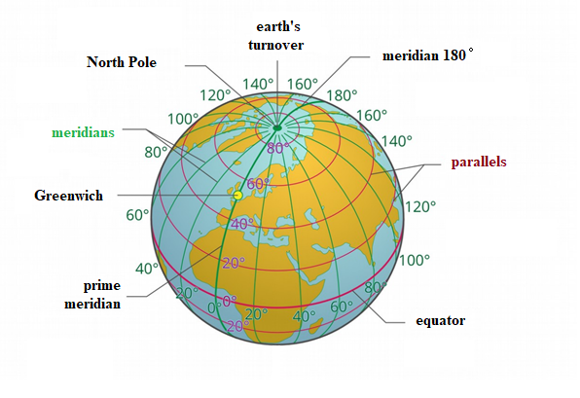
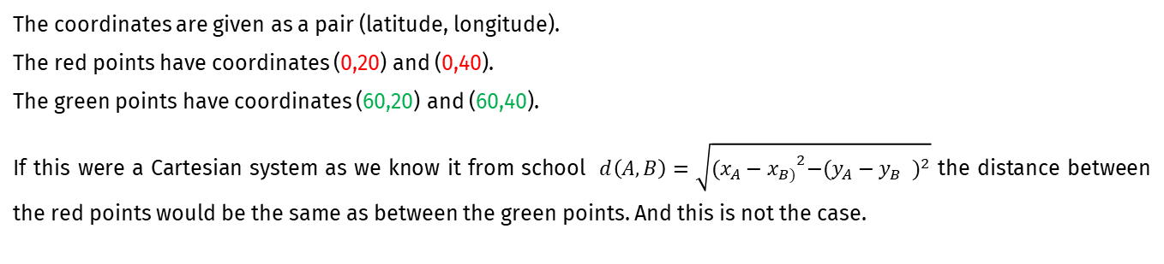
Matching of accommodation establishments
The coordinates are given as a pair (latitude, longitude).
The red points have coordinates (0,20) and (0,40).
The green points have coordinates (60,20) and (60,40).
If this were a Cartesian system as we know it from school $d\left(A,B\right)=\sqrt{{(x_{A}−x_{B)}}^{2}−{(y_{A}−y_{B} )}^{2}}$ the distance between the red points would be the same as between the green points. And this is not the case.

Slide 10
Matching by geographical coordinates
Second approach:
For large objects, such a distance was often too small to connect. But increasing it resulted in increasingly frequent false connections for small objects
Let's set two critical values.
Depending on the choice of distance, both false matches and false mismatches occured with different frequency.
How do you properly check the quality of matching?

Slide 11
Matching by geographical coordinates
Confusion matrix
 |  | Real
 | All pairs | Match (object in survey frame and webscraping) | Unmatch (object in survey frame or webscraping)
Predicted | Match | true positives (TP) | false positives (FP)
 | Unmatch | false negatives (FN) | true negatives (TN)

Slide 12
Matching by geographical coordinates
Confusion matrix
 |  | Real
 | All pairs | Match (object in survey frame and webscraping) | Unmatch (object in survey frame or webscraping)
Predicted | Match | TP = 774 | FP = 945
 | Unmatch | FN = 151 | TN = 16561
Accuracy: 0,940

Slide 13
Matching by geographical coordinates
TP = 774 | FP = 945 | Precision 0,450 | False discovery rate 0,549
FN = 151 | TN = 16561 | False ommision rate 0,009 | Negative predictive value 0,991
Recall (TPR) 0,836 | False positive rate 0,054 | Positive likelihood ratio 15,5 | Diagnostic odds ratio 89,8
False negative rate 0,163 | Specificity 0,946 | Negative likelihood ratio 0,173 | F₁ score 0,094

Slide 14
R packages
sp, rgeos – working with spatial data e.g. shape
geosphere – haversine formula, Vincenty formula
pracma – haversine formula
tidyr - data frame transformations
dplyr – pipe operator
14

Slide 15

Thank you for your attention!
Sebastian Wójcik, PhD
Statistical Office in Rzeszów
s.wojcik@stat.gov.pl
Madrit, 7th July 2023

